Slide 1
A Birth Certificate for project QGIS4BoundarySurvey?
Erik Stubkjær
QGIS 2017 Nødebo, 3rd..Meeting, August 3.

Slide 2
New OGC standards approved = calling for implementation
OGC® Land and Infrastructure Conceptual Model Standard (LandInfra)
Publication Date: 2016-12-20
Submitters | Affiliation
Paul Scarponcini, SWG chair | Bentley Systems, Inc.
Hans-Christoph Gruler, SWG co-chair | Leica Geosystems
Erik Stubkjær | Aalborg University, Dept. .. Planning
Peter Axelsson | Swedish Transport Administration
Leif Granholm | Trimble
Johnny Jensen | Vianova Systems AS
Thomas Liebich | buildingSMART International
Orest Halustchak | Autodesk
OGC candidate InfraGML encoding standards, Parts 0 – 6 and then Part 7,
developed next. OGC TC voting completed 2017-07-29 (YES, last week ;-)

Slide 3
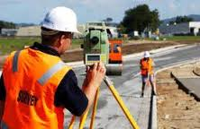
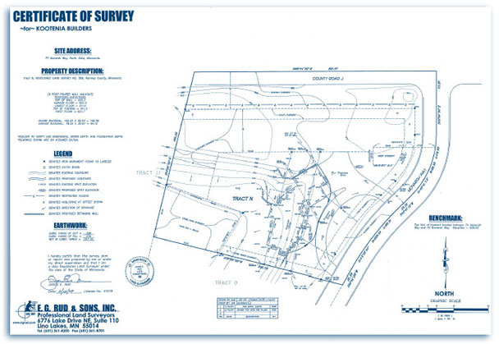
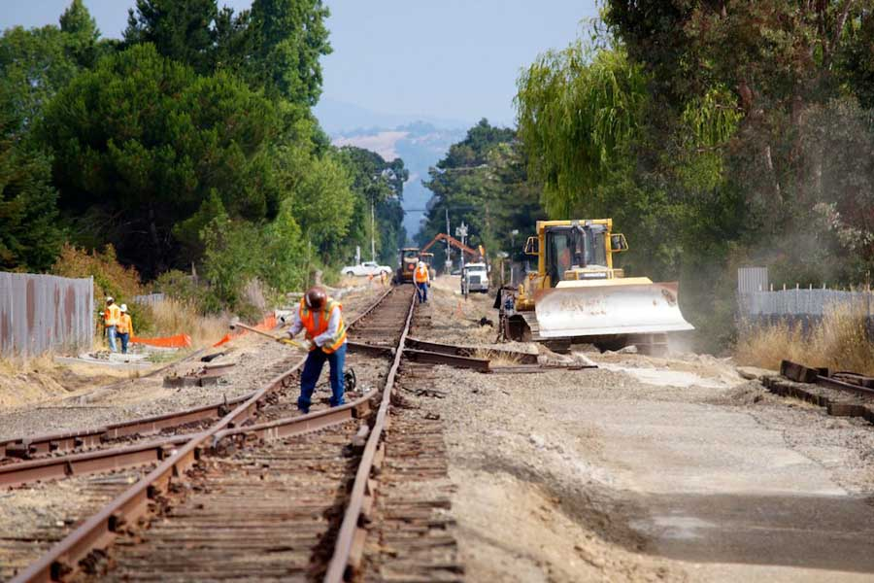
InfraGML Encoding Standards
Part 0: LandInfra Core
Part 1: LandInfra Land Features
Part 2: LandInfra Facilities & Projects
Part 3: LandInfra Alignments
Part 4: LandInfra Roads
Part 5: LandInfra Railways
Part 6: LandInfra Survey
Part 7: LandInfra Land Division
Notes:
http://www.egrud.com/new-home-construction-services.htm
http://auburnlandsurveying.com
http://www.gvalley.com/portfolio_category/survey-and-mapping/

Slide 4
OGC LandInfra Packages (Excerpt of Figure 1)
Railway

Slide 5
Need of interoperability – and a proposal for a QGIS.. role
Facility (Road, Rail)
Survey equipment
Land
Project management
SurveyResults
Public maps and records
Land Division data management in
QGIS / PostgreSQL /PostGIS
Documentation
Standards have a potential to support interoperability.
Need be implemented in software – Land Division but also Parts 1- 6
Bentley Systems, Leica Geosystems, Trimble, Autodesk

Slide 6
Overview
Potential of QGIS + PostgreSQL + PostGIS, as regards Part 7 Land Division
InfraGML Part 7 Land Division XML elements
Use Case from LandSurveyor’s point of view
Use Case from software programmer’s point of view
Items corresponding to Use Case from LandSurveyor’s point of view
Further items: Standard compliance; Report formatting
Potential of joint projects
Wikipedia, OpenStreetMap, QGIS + .. , ..
OSGeo Community Projects: An OSGeo outreach initiative promoting "open source and participatory" geospatial technology
If QGIS4BoundarySurvey: How to proceed from now ??
Notes:
https://wiki.osgeo.org/wiki/OSGeo_Community_Projects

Slide 7
Part of Table 1. InfraGML LandDivision XML elements
InfraGML XML element
.. .. (9)
lild:BoundingElement
lild:Easement
lild:ExtrusionLimit
lild:InterestInLand
lild:LandDivision
lild:LandParcel
lild:LandPropertyUnit
lild:Ownership
lild:PropertyUnit
lild:Signatory
lild:SpatialUnit
lild:Statement
.. .. (2)

Slide 8
1.a Use case for a project QGIS4BoundarySurvey
 | Subdivision of LandParcel / Boundary changes
Context | Owner(s) sell parcel(s) of PropertyUnits, e.g. to allow for residential construction on the parcel
Actors | Owners, licensedSurveyor, (recordingAgencies)
Trigger | Owner(s) request the service of the licensed Surveyor
Activities (only LandParcel/ Boundary aspects; not transaction of ownership and other rights) | PropertyUnit and Boundary data collected (from recAgen.) Boundaries established and measured; boundaries marked Parcel and boundary changes documented List of BoundaryPoints with monument types Cadastral map of change area with boundary types Cadastral account of current, transient, and resulting PropertyUnits/LandParcels

Slide 9
2.1 Current data on PropertyUnit and Boundary collected
Case Denmark:
Establish user at ‘Kortforsyningen.dk’
Get WFS-download permission
Install plugin in QGIS
Select data on PropertyUnit, LandParcel, filtered by ID and by BBox
Data reorganized in PostGIS database
geom established. Current boundaries (LineStrings) and LandParcel IDs (Centroid/ Point) within BBox rendered.

Slide 10
2.2 Boundaries established, marked, and measured
Data (pointid, location and monument type) transferred from Equipment to QGIS
Data recast into InfraGML_Survey format
Data in InfraGML_Survey format imported into PostGIS database
geom column added, Points and Polygons established

Slide 11
2.3A Boundary Point List with monument types
Querying BoundaryPoint table
Report generation; Output formatting
PointId | Easting | Northing | Mark type
057 | 397292.87 | 1317152.78 | boundaryPoint
058 | 397335.80 | 1317083.48 | boundaryPoint
059 | 397338.50 | 1317078.10 | boundaryMark
127 | 397338.83 | 1317083.42 | boundaryMark
126 | 397291.86 | 1317084.10 | boundaryMark
137 | 397291.57 | 1317064.10 | boundaryMark
.. | .. | .. | ..

Slide 12
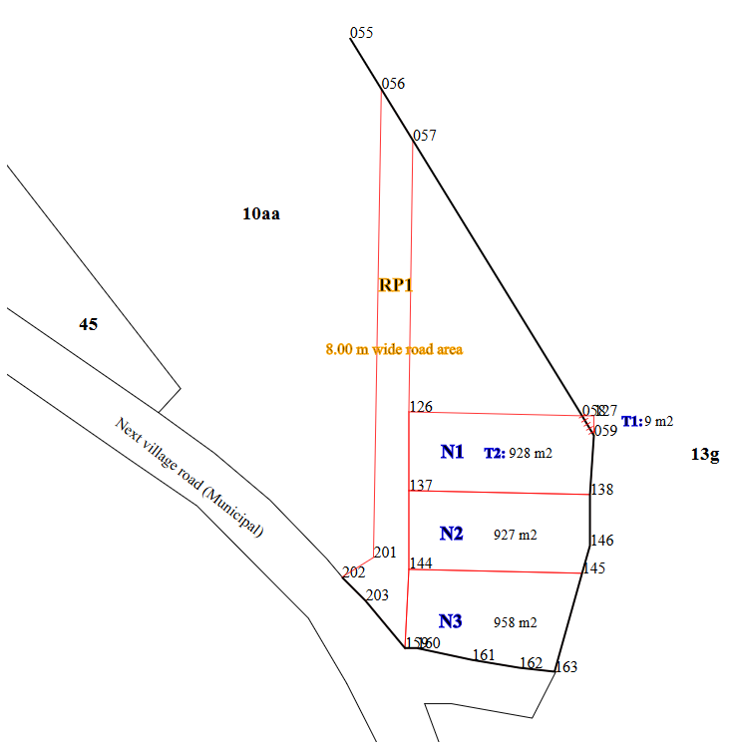
2.3B Cadastral map of changes, with LandParcel and Bo..Point IDs and boundary lines and types
LandInfra includes the property rights concepts needed to specify LandParcel and its boundary (BoundingElement); also Easement (e.g. RightOfWay), and Condominium (3D).

Slide 13
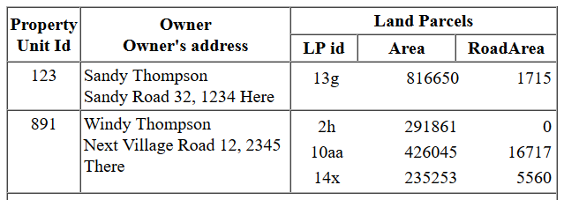
2.3C Cadastral account table
Concerned PropertyUnits/LandParcels, current details
Transfer of LandParcel parts from_and_to LandParcels, including newly established LandParcels
Summary of changed PropertyUnits with LandParcels
a) Concerned PropertyUnits/LandParcels, current details:

Slide 14
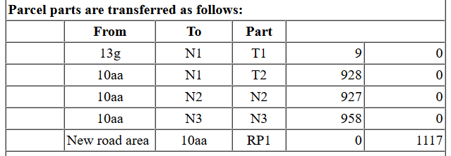
2.3C Cadastral account table
Transfer of LandParcel parts from_and_to LandParcels, including newly established LandParcels (here N1, N2, and N3, with corresponding PUx)

Slide 15
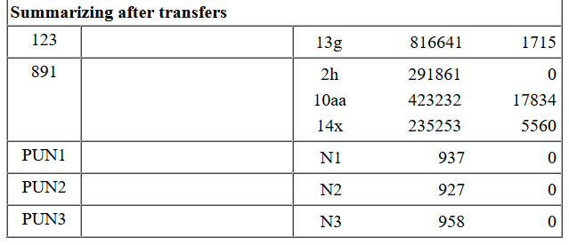
2.3C Cadastral account table
Summary of changed PropertyUnits with LandParcels (no ownership data)

Slide 16
2.B Further items: Report formatting; InfraGML compliance;
The database content need be formatted, e.g. through QGIS Print Composer into the above-mentioned Cadastral Map of Changes, Boundary Point List, and Cadastral Account Table.
Moreover, the documentation must include information on the responsible Professional(s), company, licence, case identification, etc. InfraGML Part 7 specifies lild:Statement and lild:Signatory for these data.
Finally, an application conforming to InfraGML shall support the above mentioned data elements in accordance with the GML XSD specified in http://schemas.opengis.net/infragml/part7/1.0/landdivision.xsd. This implies that the reported information must be available in xml format and that its compliance with the GML XSD is confirmed.

Slide 17
3. If a QGIS4BoundarySurvey project should be born (and even baptized :-) in Nødebo: How to proceed from now?
In my submitted abstract, I invited ‘entrepreneurs, professional mourners and magicians’ to influence this project idea.
Who is getting the upper hand ??

Slide 18
Erik Stubkjær est@land.aau.dk (+45) 23319553

