Slide 1
Strata Title in LandInfra - A Land Administration Perspective
Erik Stubkjær, Aalborg University, Denmark
Geospatial-BIM-Indoor Workshop, Boulder, Colorado, 2 June 2015

Slide 2
Strata Title in LandInfra
Terminology and legal-administrative concept
Review: 1 on OWL + 3 on CityGML ADEs + IFC
Comparison
Conclusion: Volkan Cagdas (2013) prime source of inspiration. His CityGML ADE articulates a modelling of physical and legal aspects of building parts, conformant with LADM, and in addition specifies how to accommodate for LandXML needs

Slide 3
1. Terminology and concept
Terminology: Strata title, sectional title, condominium, propiedad horizontal, ..
Concept:
Multi-level buildings, with lots/ units, which are cadastral surveyed (identifier, boundary, area)
Stairways, roof, heating system, etc., and the concerned land parcel constitutes common property
Compulsory membership of an association of apartment owners. Rights and duties in bylaws.
A share in the common property.
Both share and storey are cadastral challenges ! LADM requests classes ‘Party’ and ‘Source’ / Document

Slide 4
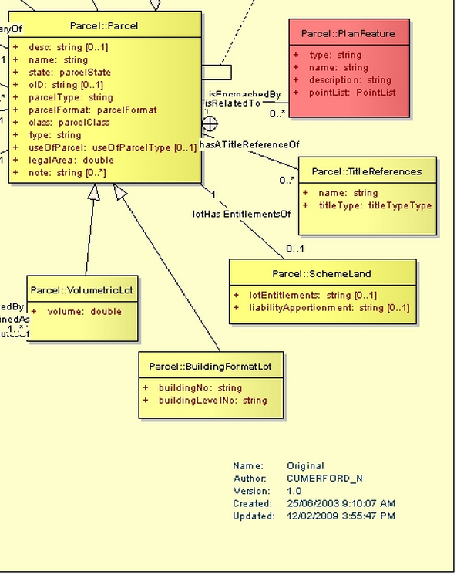
LandXML modelling of Strata title (after ePlan, 2011)

Slide 5
2. Review sources
Kean Huat Soon, Rod Thompson, and Victor Khoo (2014) Semantics-based Fusion for CityGML and 3D LandXML. (3D conf.)
Volkan Çağdaş (2013) An Application Domain Extension to CityGML for immovable property taxation: A Turkish case study. (IntJApplEarthObs+Geoinformation; CityGML-ADEs)
Yunji Kim, Hyeyoung Kang, Jiyeong Lee (2014) Developing CityGML Indoor ADE to Manage Indoor Facilities (LNGeoCarto)
Carsten Rönsdorf, Debbie Wilson, and Jantien Stoter (2014) Integration of Land Administration Domain Model with CityGML for 3D Cadastre (3D conf.)
buildingSMART International (2013) Industry Foundation Classes IFC4.

Slide 6
3. Comparison
 | LandXML +buildingLevelNo +buildingNo | LandXML +liabilityAppm.t +lotEntitlements | Physical and legal rep. of building units combined | Geometrical representation of space
Soon et al, 2014 | ? | ? | ‘hasLegalSpace’ relates physical and legal building units | Through Extern.lReference
Cagdas, 2013 | floorNumber buildingNumber | Ownership- Fraction | BuildingUsePart relating _AbstractBuilding and CondominiumUnit, etc | Implicit, extending CityGML
Kim et al, 2014 | Indoor::Storey ~ | ? | Indoor:: InteriorBuildingObject | Implicit, extending C.yGML
Rönsdorf et al, 2014 | ¬ ? | ? | relationship between LegalSpace and _CityObject | MultiSurface rep. in CityGML
IFC 4, 2013 | IfcBuildingStorey ~ | ? | IfcZone grouping of instances of IfcSpace and IfcSpatialZone | ~

Slide 7
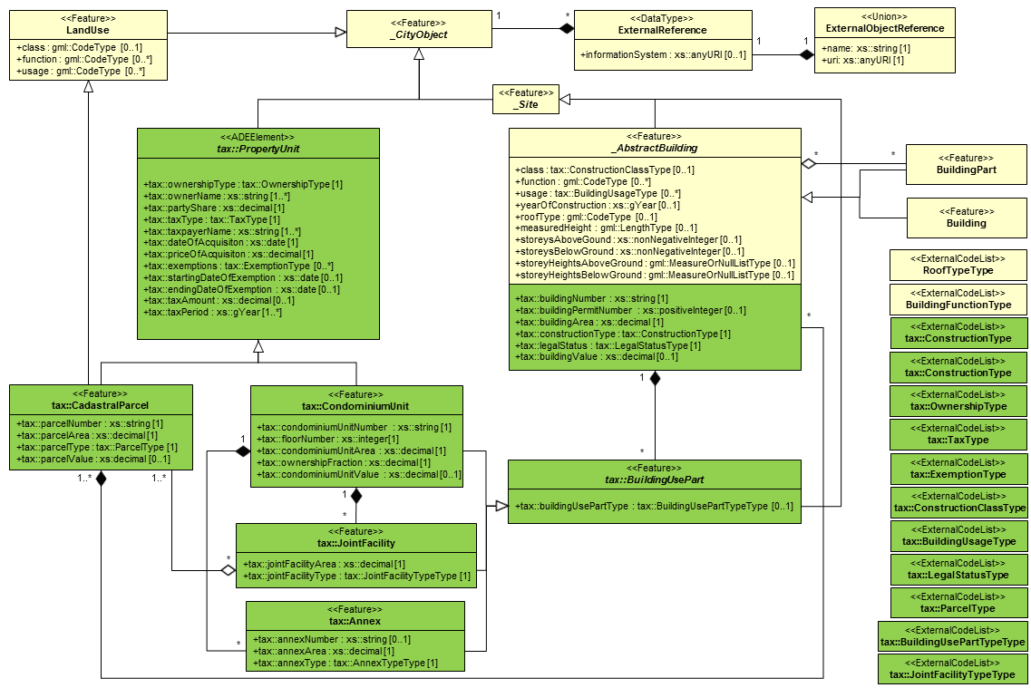
Conclusion: Çağdaş (2013) main inspiration. Shown his UMLdiagram of PropertyUnit

