Slide 1
A comparison of LandXML, ISO 19152:2012 LADM, and the draft LandInfra conceptual model
Erik Stubkjær, Aalborg University, Denmark
Geospatial-BIM-Indoor Workshop, Boulder, Colorado, 2 June 2015

Slide 2
Land-related models compared
Introduction
LandXML (XML data file format for cadastral survey)
ISO 19152:2012 (a conceptual model of a domain) Land Administation Domain Model (LADM)
Draft LandInfra Conceptual Model, comments requested Feb. 2015
Comparison
Suggestions for LandInfra

Slide 3
Introduction: Author background
Licensed cadastral surveyor 1971
Engaged in development of National Register of Buildings and Dwellings 1972-76
Professor 1977 – 2008 at Aalborg Uni, DK
European project: Modelling Real Property Transactions 2001 – 2005
Cadastre and Land Administration Thesaurus (CaLAThe) 2011 - .. with Dr. Volkan Cagdas, Yildiz.tr

Slide 4
1.A LandXML
Mandatory in NZ to lodge cadastral survey information using LandXML in 2007, next AU
XML Schema v. 1.2 issued in 2008, 2.0 in 2014
ePlan Model: an agreed Conceptual Model of a cadastral survey that meets the needs of the ICSM Jurisdictions, 2011

Slide 5
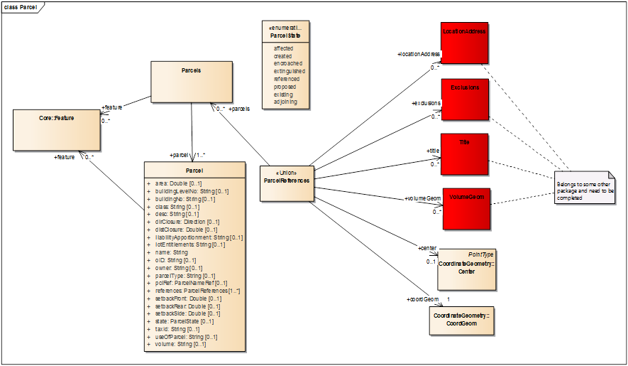
LandXML schema elements, presented as UML classes
Parcel package, one of 17 packages. - Paul Scarponcini , 2013

Slide 6
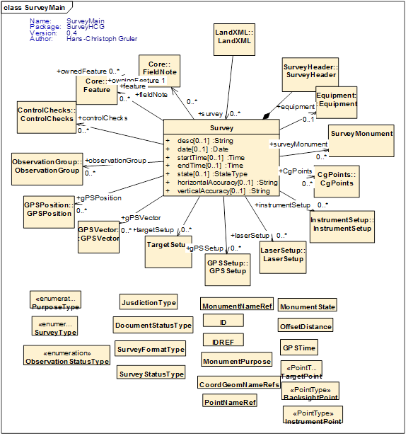
LandXML schema elements, presented as UML classes
Survey package, one of 17 packages. – P. Scarponcini , H.-C. Gruler, 2013

Slide 7
1.B ISO 19152:2012 LADM
Land administration: The process of determining, recording and disseminating information about the relationship between people and land / land tenure. (LADM)
Development by ITC/DUT, NL, within the International Federation of Surveyors (FIG) from 2002, and ISO and TC 211 during 2008 - 2012
Geospatial aspects follow the ISO/TC 211 conceptual model.

Slide 8
ISO 19152:2012 LADM
Party Package: parties (people and organizations)
Administrative Package: basic administrative units [= property units], rights, responsibilities, and restrictions (ownership rights);
Spatial Unit Package: spatial units (parcels, and the legal space of buildings and utility networks); including
the Surveying and Representation Subpackage: spatial sources (surveying), and spatial representations (geometry and topology);

Slide 9
1.C LandInfra Conceptual Model
UML conceptual model that could be implemented in GML (as InfraGML)
Initially focus on alignments/roads, survey, and land parcels, the subject areas for which there are identified needs
be synchronized with the concurrent efforts by buildingSMART International’s Industry Foundation Classes (IFCs), and be more easily integrated with OGC CityGML.

Slide 10
2. Comparisons – A. Parcel structure
LandXML | LADM | LandInfra
Parcels Parcel Parcel+parcelType | LA_BAUnit LA_Parcel LA_LegalSpaceBuildingUnit LA_LegalSpaceUtilityNetwork | LandParcel ParcelUnit ? Building, but don’t fit ? Facility, do.do.
CoordinateGeometry::CoordGeom | LA_Point LA_BoundaryFaceString LA_BoundaryFace | Point BoundingElement BoundingElement
Co.Geometry::Center Parcel+area Parcel+volume | LA_Parcel+referencePoint LA_Parcel+area LA_Parcel+volume | Bound.gElement+point ParcelUnit+area ParcelUnit+volume
Sub-domain | LandXML | LADM | LandInfra
1. Parcel | Parcels Parcel Parcel+parcelType | LA_BAUnit LA_Parcel LA_LegalSpaceBuildingUnit LA_LegalSpaceUtilityNetwork | LandParcel ParcelUnit ?? Building does not fit Facility
 | CoordinateGeometry::CoordGeom | LA_Point LA_BoundaryFaceString LA_BoundaryFace | Point BoundingElement BoundingElement
 | CoordinateGeometry::Center Parcel+area Parcel+volume | LA_Parcel+referencePoint LA_Parcel+area LA_Parcel+volume | Bound.gElement+point ParcelUnit+area ParcelUnit+volume

Slide 11
2. Comparisons – B. Legal / administrative aspects
LandXML | LADM | LandInfra
Parcel+liabilityApportionment Parcel+lotEntitlements Parcel+owner Parcel+setbackF..R..S Parcel+state Parcel+useOfParcel | ? LA_PartyMember+share LA_Party (as owner) LA_Restriction (~easement) LA_Restriction (~easement) | ? needed ? needed LandParcel+owner Missing LandInfra::Status Missing
Core::Feature SurveyMonument | LA_Point+monumentation | E.g. easement boundary missing! Missing!

Slide 12
2. Comparisons – C. Referencing and Documentation
LandXML | LADM | LandInfra
Parcel+buildingLevelNo Parcel+buildingNo Parcel+name Parcel+refer.nces(Loc.nAddress) Parcel+references (Title deed) Parcel+taxid | ~ LA_Parcel+extAddressID LA_LegalSpaceBuildingUnit +extPhys.Build.UnitID LA_Parcel+suID LA_Parcel+extAddressID | Missing! Missing! LandParcel+parcelID Missing!
SurveyHead.r+SurveyorCertific.t Core::FieldNote | LA_Party (Survey and FieldNote author) LA_SpatialSource LA_AdministrativeSource | Missing! LandInfra (Core) Document class missing

Slide 13
3. Suggestion summary
Buildings and building parts, needed for strata title / condominiums are so far not addressed (cf. LandXML’s Parcel+buildingLevelNo and Parcel+buildingNo; LADM’s LA_LegalSpaceBuildingUnit; ).
The LandInfra draft hardly reflects the different document types of a Project. Even if data are assumed to be stored in a database and recombined, recording of responsible person seems warranted and calls for a 'segmentation' of data in one way or another
Physical features (edge of house, ditches, .., SurveyMonument) and legal features, e.g easement boundary, need be at least enumerated by the standard.
Post address is important in practice, should be included

Slide 14
Questions or comments ?
est@land.aau.dk

